Slide 1
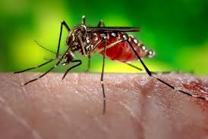
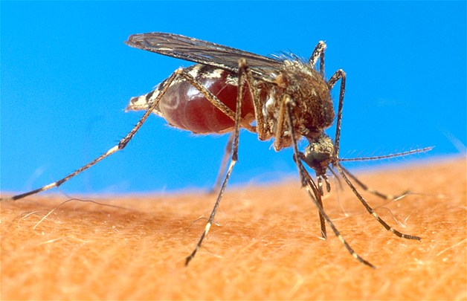
DEPARTMENT OF HEALTH SERVICES
CITY OF ENNIS
MOSQUITO CONTROL
PROGRAM
August 23, 2016
by Chauncy Williams , Health Director

Slide 2
Since May - Zika Virus In Texas – August 23, 2016
Texas has had 125 reported cases of Zika virus disease. This count includes: three pregnant women, two infants infected before birth, and one person who had sexual contact with a traveler.
Texas Zika Cases by County:
County | Cases
Bell | 4
Bexar | 8
Brazos | 1
*Collin | 3
*Dallas | 28
*Denton | 4
El Paso | 1
*Ellis | 1
Fort Bend | 6
Frio | 1
Gray | 1
Galveston | 2
County | Cases
*Grayson | 1
Greg | 1
Hamilton | 1
Harris | 33
Jefferson | 1
Lubbock | 1
Medina | 1
*Palo Pinto | 1
Randall | 1
*Tarrant | 14
Travis | 3
Val Verde | 1
County | Cases
Walker | 1
Williamson | 3
*Wise | 1
*North Central Texas Counties
Total 125

Slide 3
Before Zika – the West Nile Outbreak In Ellis County October 31, 2012
 | WN Death | DOD | City | Zip | County | Onset | Age | Sex | Race | Hispanic | Diagnosis
1 | No |  | Ferris | 75125 | Ellis | 6/17/2012 | 45.4 | F | W | Y | WN Fever
2 | No |  | Waxahachie | 75165 | Ellis | 7/9/2012 | 21.3 | F | U | U | WN Fever
3 | No |  | Ferris | 75125 | Ellis | 6/30/2012 | 41.9 | F | W | Y | WN Fever
4 | No |  | Waxahachie | 75167 | Ellis | 7/8/2012 | 56.8 | M | W | N | WN Fever
5 | No |  | Ferris | 75125 | Ellis | 7/4/2012 | 48.2 | M | W | N | WN Fever
6 | No |  | Red Oak | 75154 | Ellis | 7/20/2012 | 42.0 | F | B | N | WN Fever
7 | No |  | Waxahachie | 75165 | Ellis | 7/20/2012 | 24.1 | F | W | N | WN Fever
8 | No |  | Waxahachie | 75167 | Ellis | 7/27/2012 | 35.6 | M | W | N | WN Fever
9 | No |  | Waxahachie | 75167 | Ellis | 8/1/2012 | 40.9 | F | W | N | WN Fever
10 | No |  | Waxahachie | 75165 | Ellis | 7/30/2012 | 48.9 | F | W | N | WN Fever
11 | No |  | Waxahachie | 75165 | Ellis | 8/6/2012 | 48.6 | M | U | U | WN Fever
12 | No |  | Waxahachie | 75165 | Ellis | 8/10/2012 | 45.6 | M | W | N | WN Fever
13 | No |  | Midlothian | 76065 | Ellis | 8/9/2012 | 29.9 | F | W | N | WN Fever
14 | No |  | Midlothian | 76065 | Ellis | 8/16/2012 | 40.8 | F | U | U | WN Fever
15 | No |  | Red Oak | 75154 | Ellis | 8/24/2012 | 48.2 | F | U | N | WN Fever
16 | No |  | Red Oak | 75154 | Ellis | 9/9/2012 | 68.6 | M | U | U | WN Fever
17 | No |  | Midlothian | 76065 | Ellis | 7/9/2012 | 1.7 | F | W | N | WNND
18 | Yes | 8/3/2012 | Midlothian | 76065 | Ellis | 7/21/2012 | 75.2 | F | W | N | WNND
19 | No |  | Midlothian | 76063 | Ellis | 7/30/2012 | 15.4 | F | W | N | WNND
20 | No |  | Ovilla | 75154 | Ellis | 7/31/2012 | 38.1 | F | W | N | WNND
21 | Yes | 8/28/2012 | Midlothian | 76065 | Ellis | 8/17/2012 | 81.5 | F | W | N | WNND
22 | No |  | Waxahachie | 75165 | Ellis | 8/12/2012 | 60.0 | M | W | Y | WNND
23 | No |  | Waxahachie | 75165 | Ellis | 8/31/2012 | 52.2 | M | W | N | WNND
24 | No |  | Red Oak | 75154 | Ellis | 9/4/2012 | 54.2 | F | W | N | WNND
25 | No |  | Midlothian | 76065 | Ellis | 8/15/2012 | 39.3 | M | U | U | WNND
WN = West Nile Fever WNND = West Nile neuroinvasive disease (severe cases) .
No human WNND or WNF cases have been reported within the City of Ennis.

Slide 4
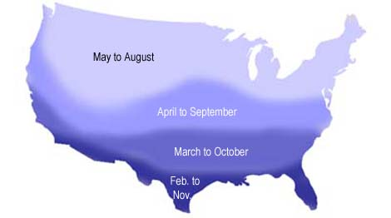
West Nile Virus Ennis
Positive Sample Pools WNV Mosquitos
2012 | 2013 | 2014 | 2015 | 2016
Address Date | Address Date | Address Date | Address Date | Address Date
1. 1311 Sundale 06/27 | 2004 Jack McKay 10/3 | 103 Ave. D 08/28 | 504 W. Waco 08/10 | 504 W. Waco 06/28
2. 1100 Savanna 07/18 | 105 Ave. D 10/16 | 504 W. Waco 08/28 | 504 W. Waco 09/24 | 901 Park 07/13
3. 1311 Oak Creek 07/24 | 808 E. Burnett 10/28 | 103 Ave. D 10/29 | 901 Park 10/05 | 1205 Edgewood 07/18
4. 1207 N. Preston 07/30 |  |  |  | 504 W. Waco 7/25
5. 904 N. Preston 08/29 |  |  |  | 1205 Edgewood 07/27
6. 1000 E. Burnett 09/20 |  |  |  | 1205 Edgewood 08/01
7. |  |  |  | 501 W. Waco 08/01
8. |  |  |  | 901 Park 08/01
9. |  |  |  | 2804 Tenison 08/03
10. |  |  |  | 1205 Edgewood 08/09
11. |  |  |  | 103 Ave. D 08/09
12. |  |  |  | 504 W. Waco 08/09
13. |  |  |  | 814 Oak Creek 08/10 Goldenrod 08/11
# of Traps Set = 116 X Ground Sprayed = 27 | # of Traps Set = 265 X Ground Sprayed = 30 | # of Traps Set = 174 X Ground Sprayed = 8 | # of Traps Set =186 X Ground Sprayed = 13 | # of Traps Set = 136 X Ground Sprayed = 16
Mosquito season varies from year to year depending on temperature, moisture and other conditions. The map shows approximate periods when mosquitoes may be most active, with activity tapering off for a month or more before and after.

Slide 5
West Nile Virus Ennis 2012 to August 23, 2016
6 Positives 3 Positives 3 Positives 3 Positives 14 Positives

Slide 6
WNV Disease Surveillance & Abatement
When the application of adulticide is warranted, staff sprays one half of the City one night and the other half of the City two nights later to disrupt the mosquito life cycle
Health Department staff also respond to reports of stagnant water on a continuous basis as part of the WNV disease abatement program
YTD 2016, 14 mosquito pools within Ennis have tested positive for WNV, no human cases of the virus have been identified
Sixteen traps have captured 150+ mosquitoes since late-June and staff has been spraying since that time

Slide 7
MOSQUITO CONTROL
A SMALL BUT VITAL PROGRAM
3 Health Generalist FTE’s and a 0.5 FTE Park Department employee are assigned to the program.
Equipment, Shipping, and Supplies.
~$7,000 budget for operations.
Actual Cost per FY:
2012 Total Cost: $11,850.00;
2013 Total Cost: $9980.00;
2014 Total Cost: $4554.00;
2015 Total Cost: $6480.00
2016 Estimated Cost: $10,000.00

Slide 8
To Report Mosquito Related Problems or For Additional Information Regarding This Presentation Please Feel Free to Contact the City of Ennis Health Department at:
105 S. Preston Street
972-875-1234 or by Email at:
healthdept@ennis-texas.com
CITY OF ENNIS
CWMS 2016

