Slide 1
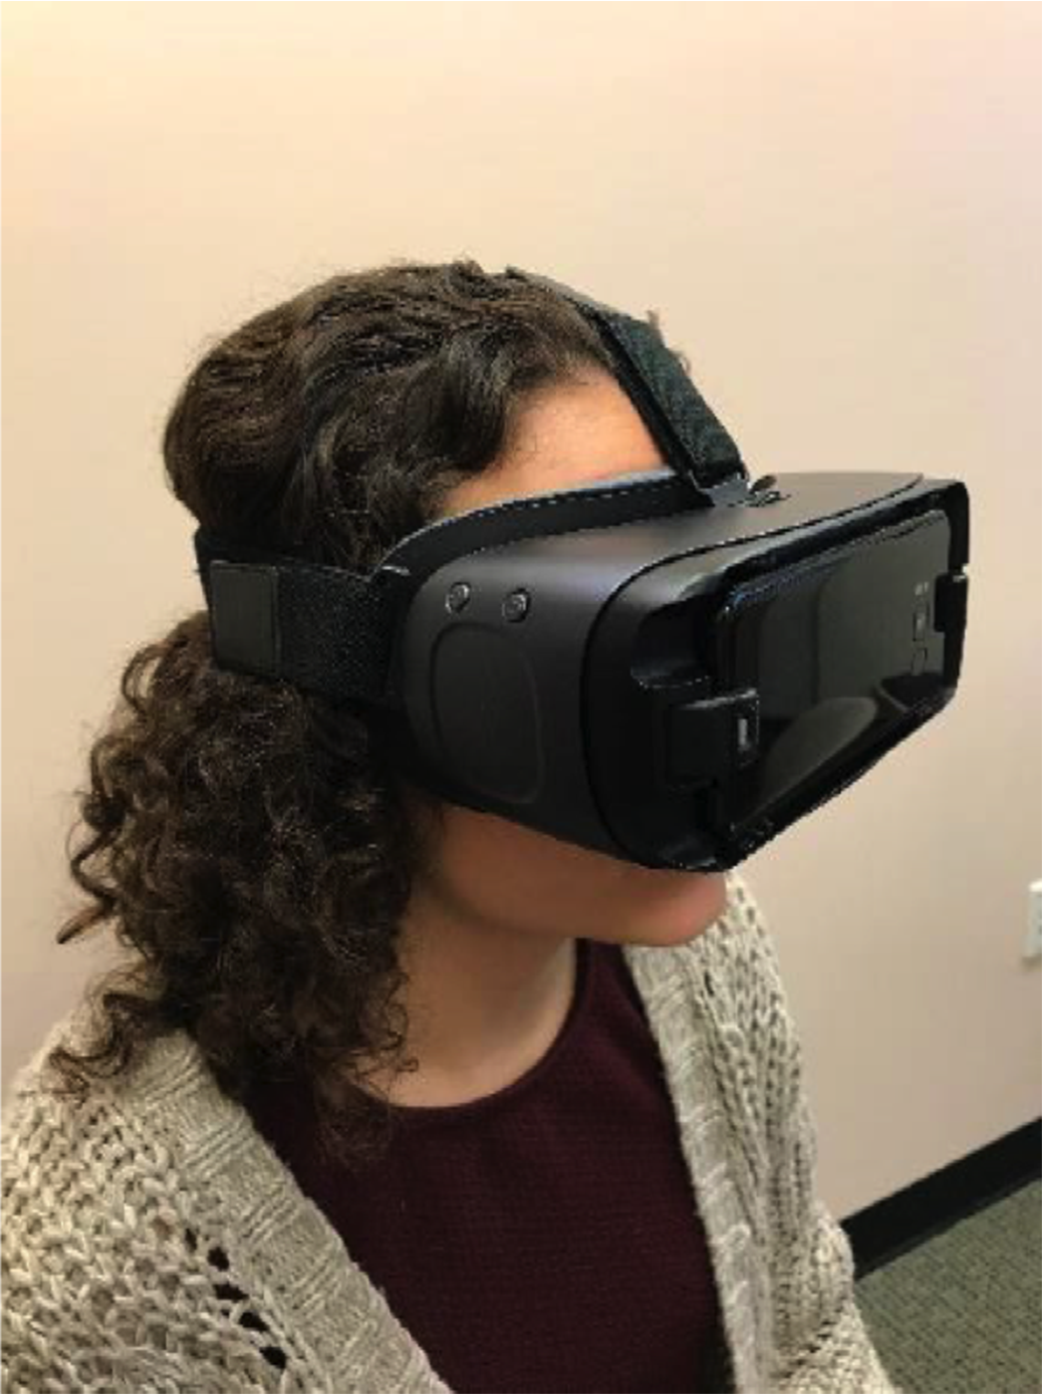
A new use for head mounted displays for low vision (LVES)

Slide 2
Use LVES to detect trachoma
Trachoma is the leading cause of preventable blindness in the world
1.2 million are irreversibly blind
Caused by bacterial infection
LCIF's SightFirst program has given more than $47 million towards eliminating trachoma

Slide 3
Advantages of head mounted displays
Hands free!
A single person can simultaneously flip eyelids and take pictures using a foot pedal
More cost effective than hiring two people
Pictures can be evaluated in virtual reality
Barcodes automatically identify patients

Slide 4
Road to village in Tanzania

Slide 5
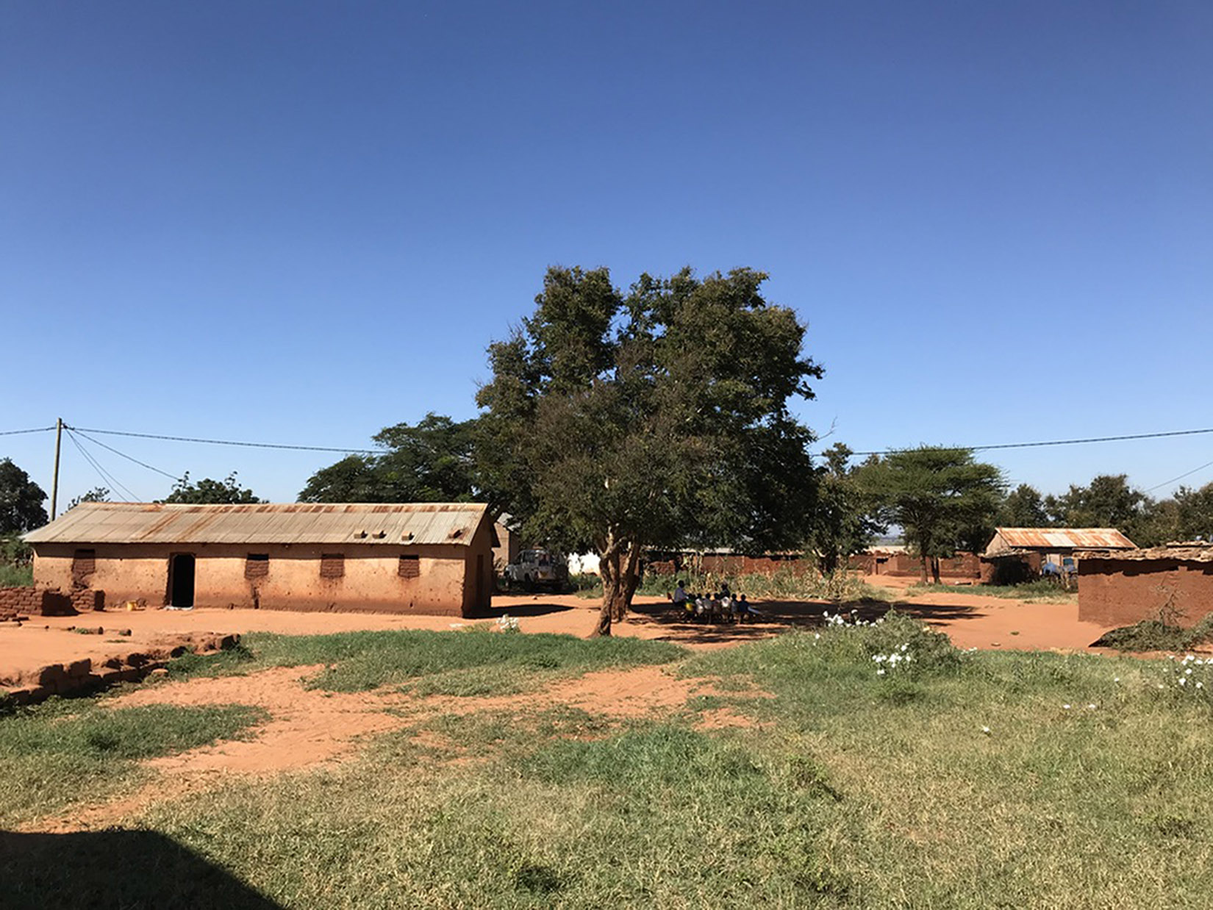
Village in Tanzania

Slide 6
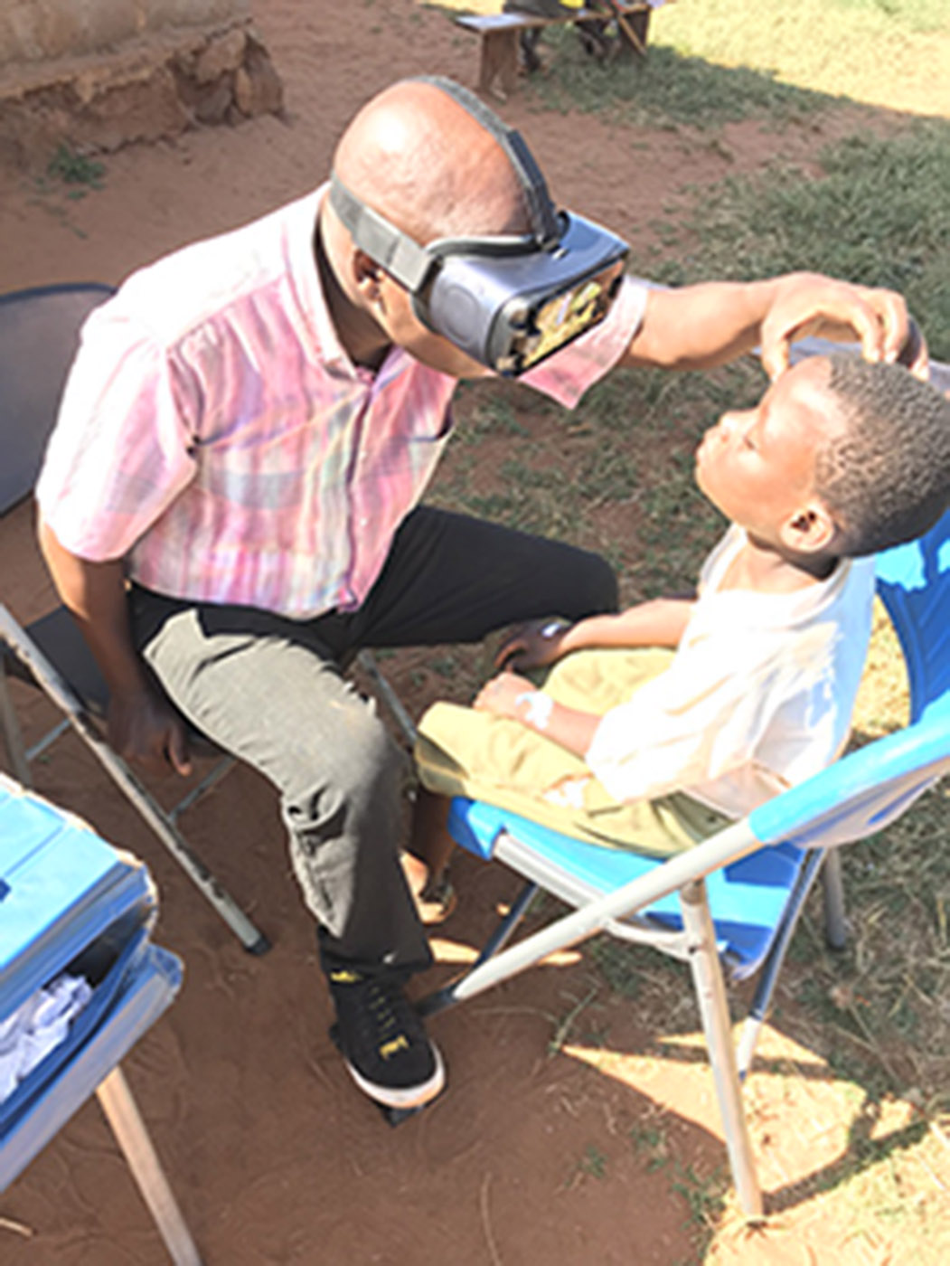
Testing in Tanzania

Slide 7
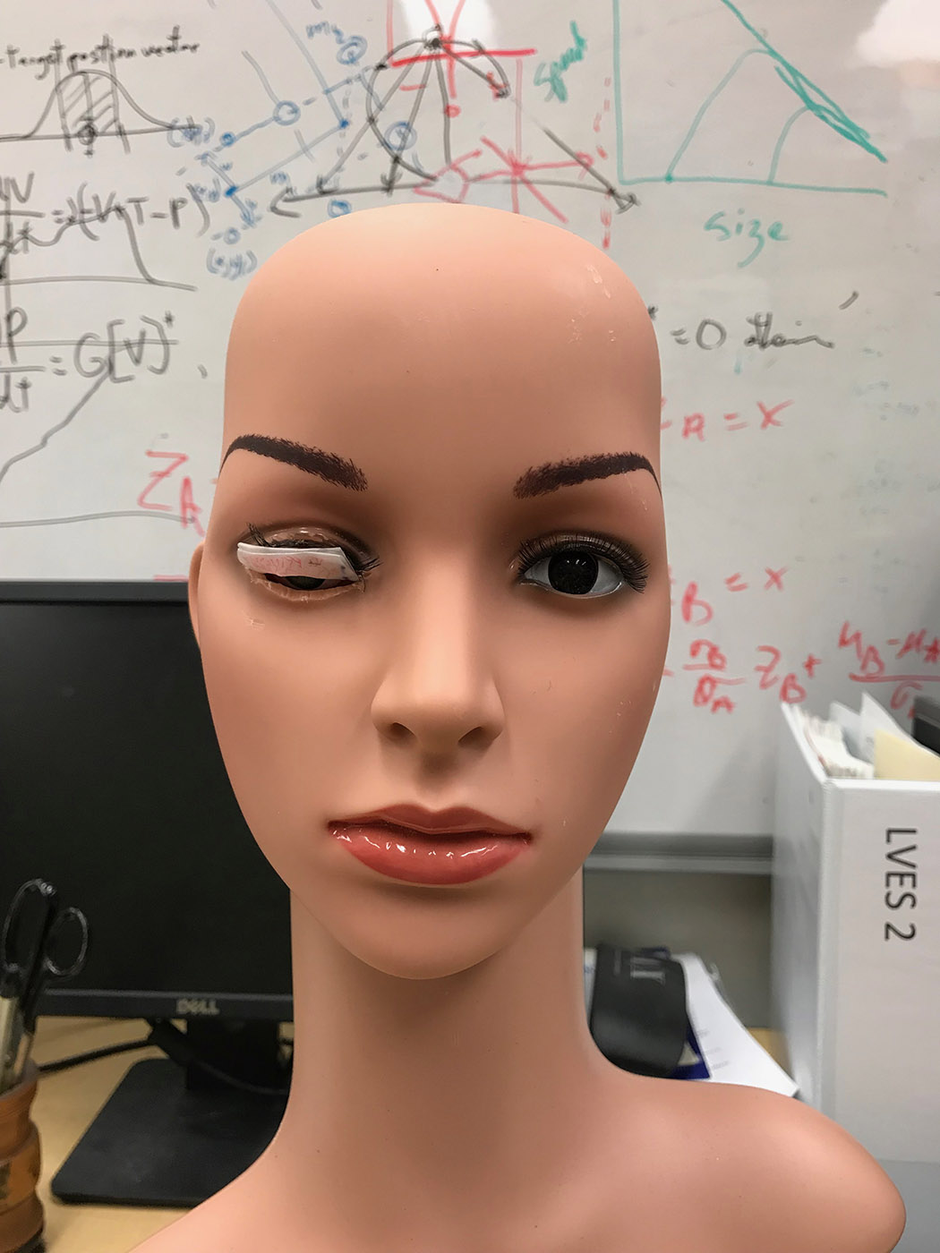
Test subject at Hopkins

